Slide 1

LOAN PREDICTION

Slide 2
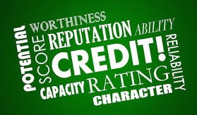


Slide 3
INTRODUCTION
A system called loan worthiness prediction system is such that it helps an organization in making right decisons to approve or reject the loan request of customers.
The dataset used to build the model has 614 observations and 13 variables.
The dataset had some missing values which needed to be filled for a successful model prediction.

Slide 4
AIM
To build a model that predicts a customer's credibility/worthiness for loan acquistion.
PROBLEM STATEMENT
One of the major challlenges in the financial sector is being able to determine a customer's credibility for loan acquistion not just with the use of collarteral only. Hence a credible and more accurate method is required , this was the incentive for this project.

Slide 5
ARCHITECURE OF THE PROPOSED MODEL
INPUT CUSTOMER DETAILS
TEST SET
DATA PREPOCESSING
MODEL
TRAINING SET
LOGISTICS REGRESSION
ALGORITHM

Slide 6
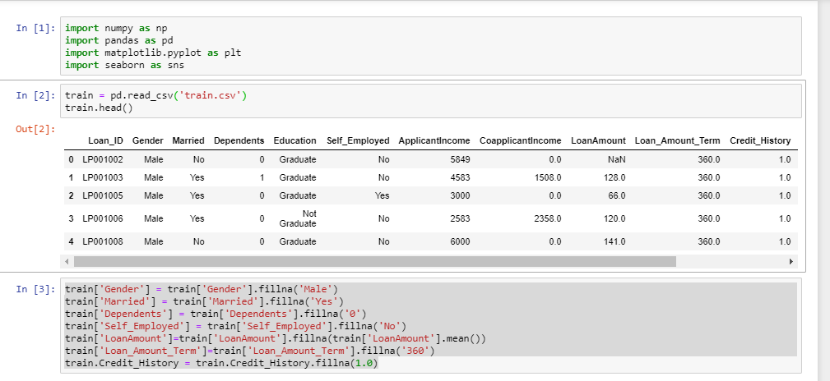
DATA OVERVIEW

Slide 7
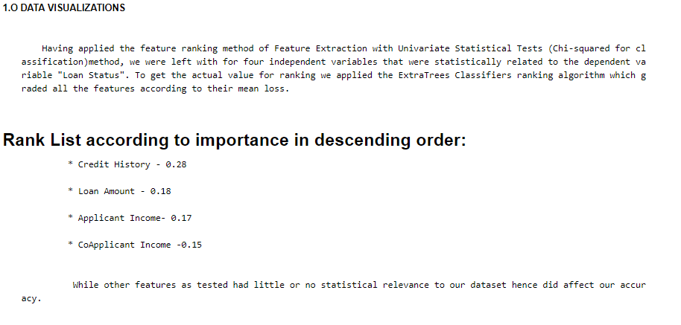

Slide 8
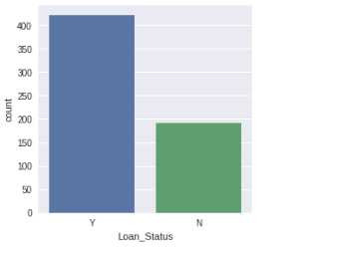

Slide 9
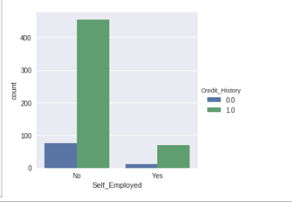
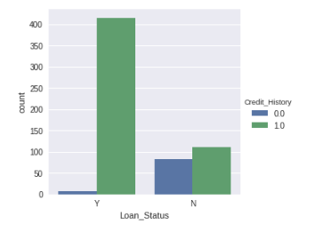

Slide 10
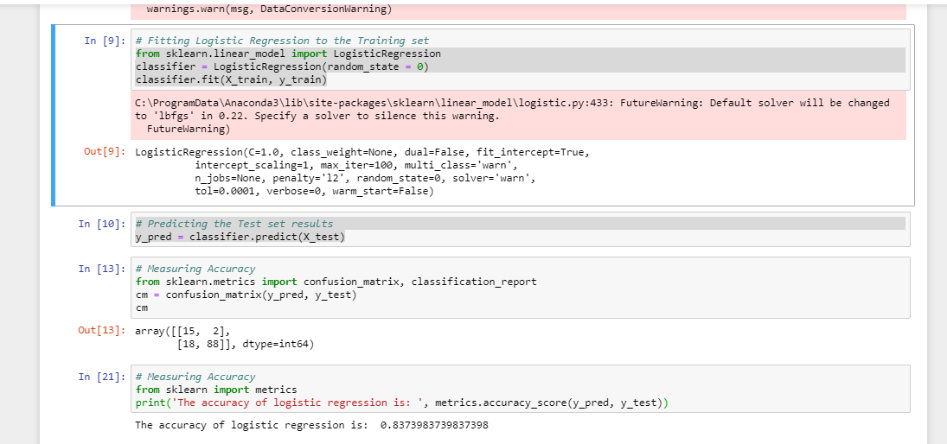
MODEL PREDICTION

Slide 11
ALGORITHM COMPARISON
MODELS | ACCURACY( %)
SVC | 0.829
KNN | 0.821
Logistic Regression | 0.837
Decision Tree | 0.699
Naive_Bayes | 0.829
Random Forest | 0.756

Slide 12
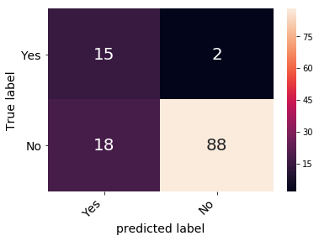

Slide 13
CONCLUSION
Using logistic regression, with an accuracy of approximately 84%, the model proved to be the most optimal for predictive analysis.

Slide 14
RESOURCES
KAGGLE
ZINDI
GITHUB
www.towardsdatascience.com

Slide 15
LOAN WORTHINESS PREDICTION
GROUP 2
TEAM MEMBERS
AKINTOYE STEPHEN
TIMOTHY MAYOR
JUSTICE CHUKWUkA ONUOHA
AMINAH MARDIYYAH RUFAI
AISHA
IBRAHIM OLUBIYI
OLUSOLA ADEGOKE

